Slide 1

Module 1
Master of Computer Applications /
Master of Science in Information Technology
Subject code – Web Programming
Introduction to CSS

Slide 2




What is CSS
Module No.1
Cascading Style Sheets
Contains the rules for the presentation of HTML.
+ =
HTML CSS Web Page
CSS was introduced to keep the presentation information separate from HTML markup (content).
Mehtab Mehdi Asstt Prof School of CS & IT

Slide 3
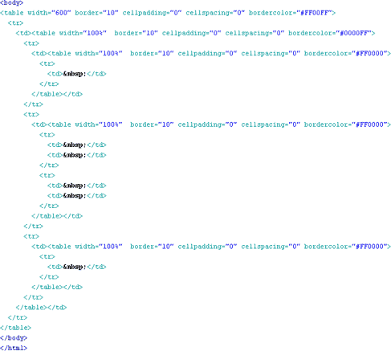
Before CSS
Initially Designers used presentation tags like (FONT, B, BR, TABLE etc.) and spacers GIFs to control the design of web pages.
Module No.1
•
Mehtab Mehdi Asstt Prof School of CS & IT

Slide 4


Module No.1
Any modification in the design of websites was a very difficult and boring task , as it evolves manually editing every HTML page.
Mehtab Mehdi Asstt Prof School of CS & IT

Slide 5
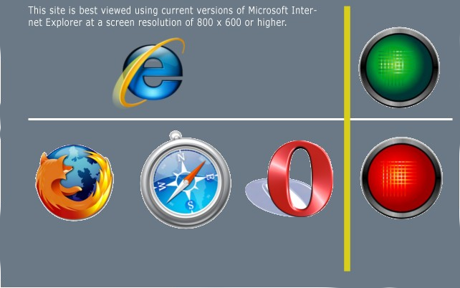
Providing support for multiple browsers was a difficult task.
Module No.1
Mehtab Mehdi Asstt Prof School of CS & IT

Slide 6
Sources of Styles
Module No.1
Author (developer) Styles
Inline Styles - As inline attribute “style” inside HTML tags
<div style=“font-weight: bold;”>I am bold</div>
•
Embedded Styles - As embedded style tag with in HTML document.
<html>
<head>
<title>Welcome to Vendio!</title>
<style>
.footer { width:90%;
}
</style>
</html>
•
Linked Styles - Inside separate files with .css extension
<link rel="stylesheet" href=“external.css" type="text/css" />
Mehtab Mehdi Asstt Prof School of CS & IT

Slide 7
Sources of Styles(contd.)
Module No.1
User Style sheets
This file contains the user created styles .
[firefox profile folder]/ chrome/userContent-example.css is the current user’s style sheet file for the firefox.
Browser default style sheet
This file contains default styles for all users of a browser
[firefox folder]/res/html.css is the default style sheet file for the firefox.
Mehtab Mehdi Asstt Prof School of CS & IT

Slide 8
CSS Selectors
Module No.1
ID based ( #)
HTML
<div id=“content”> Text
</div>
CSS
#content {
width: 200px;
}
ID selectors should be used with single elements.
Mehtab Mehdi Asstt Prof School of CS & IT

Slide 9
Class based selector
Module No.1
Class (.)
HTML |  | CSS
<div class=“big”> | .big{
Text |  | width: 200px;
</div> | }
<div>
<span class=“big”>some | text </span>
</div>
Class based styles can be used by multiple HTML elements.
Mehtab Mehdi Asstt Prof School of CS & IT

Slide 10
Tag based selectors
Module No.1
Tag (Tag name)
HTML |  | CSS
<div> | DIV {
Text |  | width: 200px;
</div> | }
<div> | SPAN {
<span>some text </span> |  | font-size:130%;
</div> | }
<span>some other text </span>
Mehtab Mehdi Asstt Prof School of CS & IT

Slide 11
Grouping
Module No.1
Multiple selectors can be grouped in a single style declaration by using , .
H1, P , .main { font-weight:bold;
}
Mehtab Mehdi Asstt Prof School of CS & IT

Slide 12
Descendant selectors
Module No.1
Descendant selectors are used to select elements that are descendants (not necessarily children) of another
element in the document tree.
HTML
<div class=“abc”>
<div>
<P>
Hello there!
</p>
</div>
</div>
CSS
DIV.abc P {
font-weight:bold;
}
Mehtab Mehdi Asstt Prof School of CS & IT

Slide 13
Child selectors
Module No.1
A child selector is used to select an element that is a direct child of another element (parent). Child selectors will not select all descendants, only direct children.
HTML
<div >
<div class=“abc”>
<P>
Hello there!
</p>
</div>
</div>
CSS
DIV.abc > P {
font-weight:bold;
}
Mehtab Mehdi Asstt Prof School of CS & IT

Slide 14
Universal selectors
Module No.1
Universal selectors are used to select any element.
* {
color: blue;
}
Mehtab Mehdi Asstt Prof School of CS & IT

Slide 15
Adjacent sibling selectors
Module No.1
Adjacent sibling selectors will select the sibling immediately following an element.
DIV.abc + P {
font-weight: bold;
}
will work for
<div>
<div class=“abc”>Message</div>
<P>Hello there!</p>
</div>
Mehtab Mehdi Asstt Prof School of CS & IT

Slide 16
Attribute selectors
Module No.1
Attribute selectors selects elements based upon the attributes present in the HTML Tags and their value.
IMG[src="small.gif"] { border: 1px solid #000;
}
will work for
<img src=“small.gif” />
Mehtab Mehdi Asstt Prof School of CS & IT

Slide 17
CSS Pseudo-classes
Module No.1
selector:pseudo-class { property: value }
:link
:visited
:hover
:active
} Link (A tag) related pseudo classes
:after
:before
:first-child
:focus
:first-letter
:first-line
:lang
Mehtab Mehdi Asstt Prof School of CS & IT

Slide 18
CSS Values
Module No.1
Words: text-align:center;.
Numerical values: Numerical values are usually followed by a unit type.
font-size:12px;
12 is the numerical value and px is the unit type pixels.
Absolute Values – in, pc, px, cm, mm, pt
Relative Values – em, ex, %
Color values: color:#336699 or color#369 or rgb(255, 255, 255).
Mehtab Mehdi Asstt Prof School of CS & IT

Slide 19
Categories of CSS properties
Module No.1
Positioning and layout handling related.
Background related properties.
Font and text related
Links related.
Lists related.
Table related.
Mehtab Mehdi Asstt Prof School of CS & IT

Slide 20

Cascade
Module No.1
The CSS cascade assigns a weight to each style rule. When several rules apply, the one with the greatest weight takes precedence.
Order of preference for various styles:
Default browser style sheet (weakest)
User style sheet
Author style sheet
Author embedded styles
Author inline styles (strongest)
Mehtab Mehdi Asstt Prof School of CS & IT

Slide 21
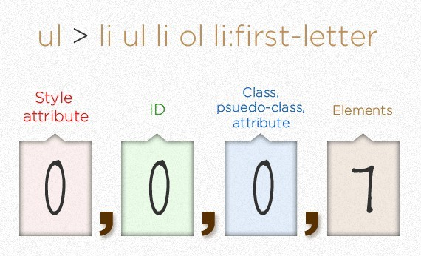
CSS Specificity
Module No.1
Rule 1. CSS File >> Embedded >> Inline
Rule 2. TAG >> class >> ID
Mehtab Mehdi Asstt Prof School of CS & IT

Slide 22
Inheritance
Module No.1
Styles that relate to text and appearance are inherited by the descendant elements.
Styles that relate to the appearance of boxes created by styling DIVs, paragraphs, and other elements, such as borders, padding, margins are not inherited.
Mehtab Mehdi Asstt Prof School of CS & IT

